Slide 1


JOBS AND
CAREER
Team Gradboost
PROJECT CODE PP22/J609
Online Job Postings
Presenters Constance Adusei Joseph Ologunja
HDSC WINTER ‘22

Slide 2
Meet our Team
Abdulhaqq Salmon Ayotomide Akin-Ojo
Pelumi Ogunlusi Constance Adusei
Damilola Omolusi
Daniel Olatunji Elishama Yomi-Agbajor
Emoghena Itakpe Evan Olonde
Joseph Ologunja
Project Lead
Isibor Ekhoegbe
Mctrinity Chisom
Nitika Yadav Oghenero Egbine
Ogwang Tonny
Sonola Moyosoluwalorun Teniola Ayedun
Ugochukwu Umeh Victor Anoke
Ibrahim Aderinto
Assistant Project Lead
Pelumi Ogunlusi
Query Analyst

Slide 3

Intoduction
Problem Statements
Outline
Online Job Posting Dataset
Methodology Results
Recommendations

Slide 4

Introduction
The demand for jobs in the labor market is continuously evolving with the use of technology to advertise job openings.
There is need to understand the demand for certain job titles and professions and identify skills that are most frequently required by employers.
The online job market is a strong predictor of overall labour needs in an economy. Online job postings data are a rich source of labour market information.

Slide 5
Problem Statement
What jobs are in high demand
?
What skills are in high demand
?
Have the demand for these skills changed with time
?

Slide 6
Online Jobs Posting
The dataset was scraped from a Yahoo! Mailing Group
Available on Kaggle - https://www.kaggle.com/madhab/jobposts
19,000 job postings that were posted through the Armenian Human Resource Portal Career Center from 2004 - 2015.
There are 24 columns in the dataset with various aspects of a job post arranged in tabular format.

Slide 7
Exploratory Data Analysis
Data Cleaning
removing missing values and duplicated rows
Problem Analysis
using python methods on the dataset to answer the problem statements
Methodology
Results
Visualizations

Slide 8

Results
There was a high demand for jobs in March
There was low demand for jobs during September to January
Accountant positions were highly demanded
Language skills and Microsoft Office skills were mostly required by employers

Slide 9
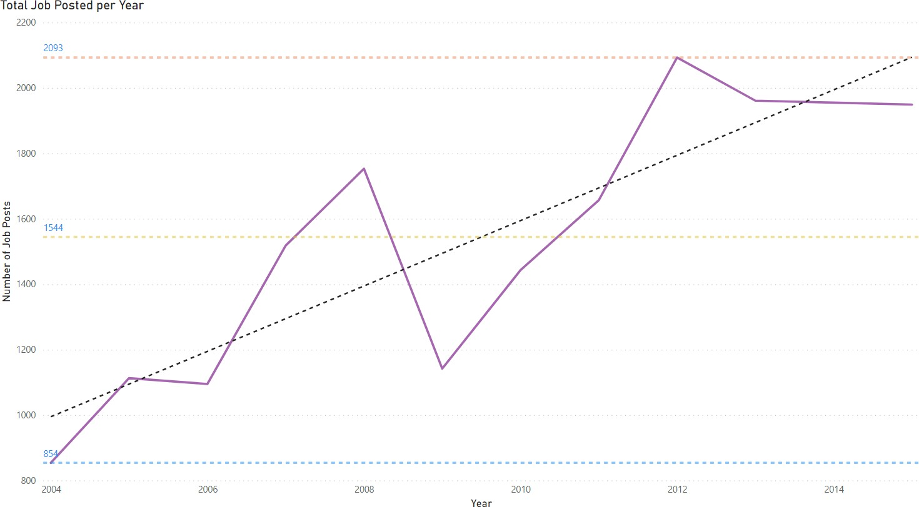

Slide 10
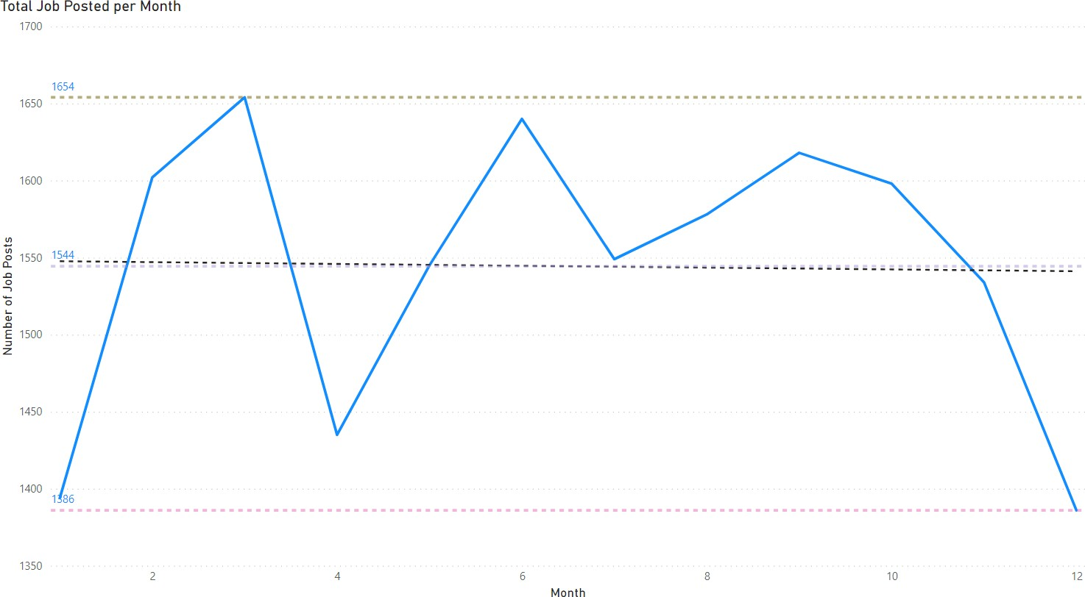

Slide 11
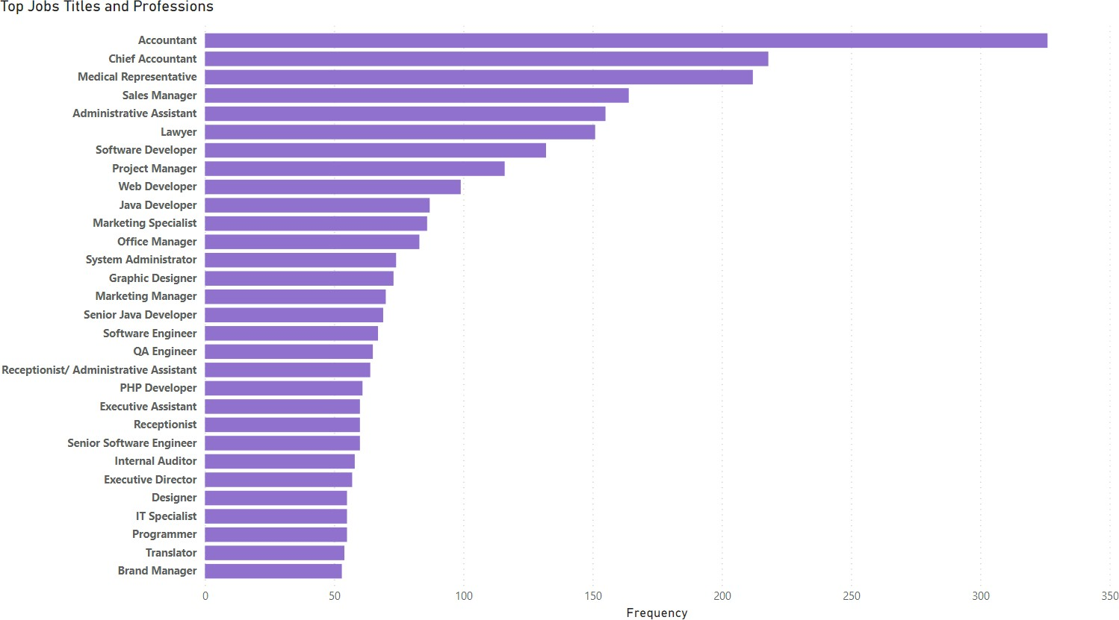

Slide 12
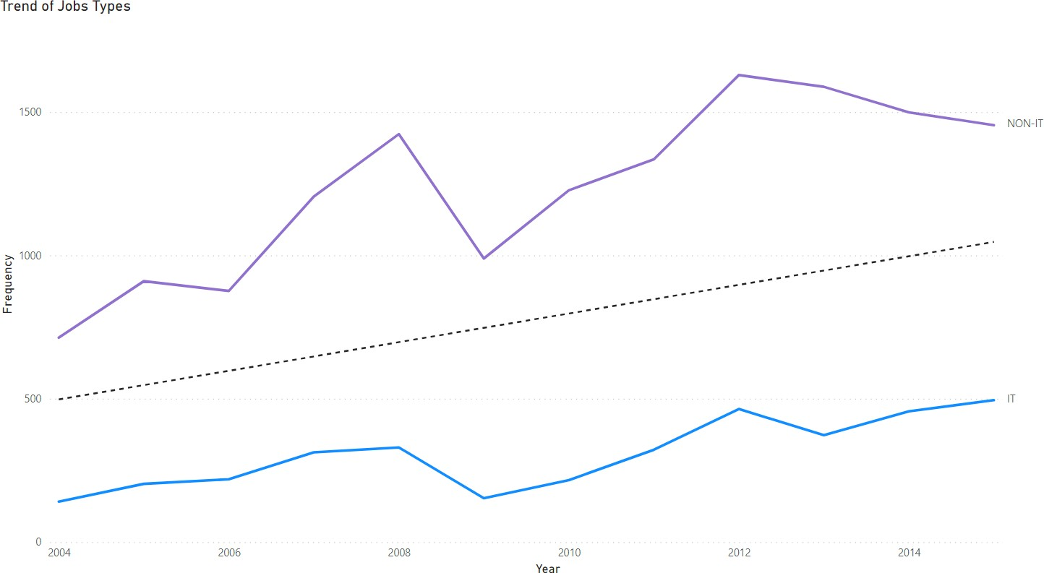

Slide 13
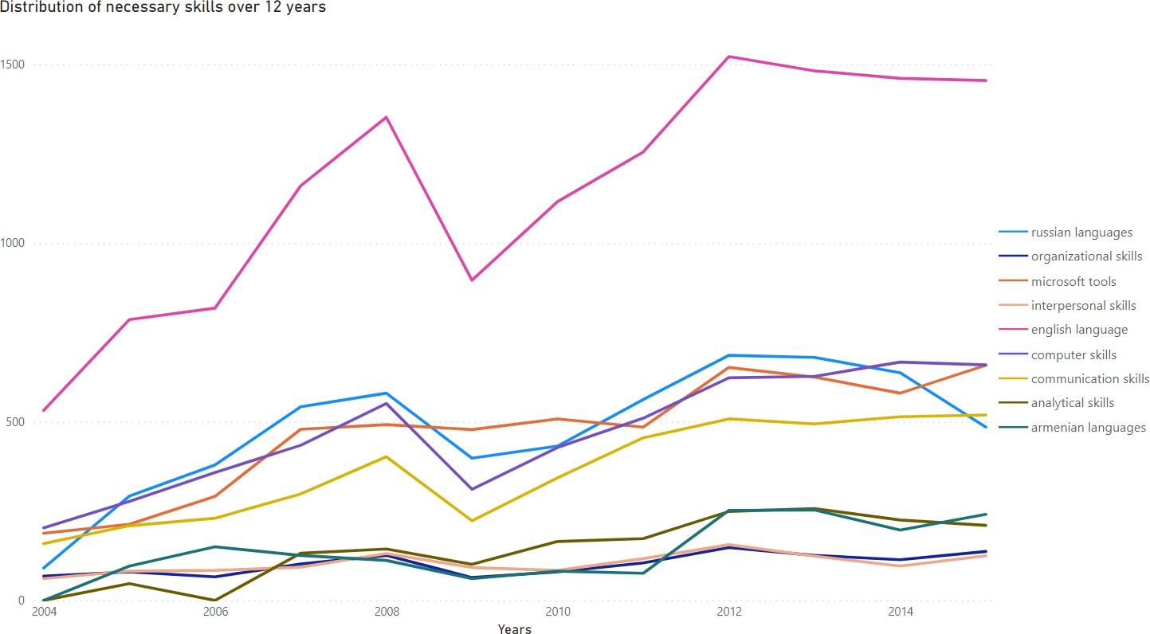

Slide 14
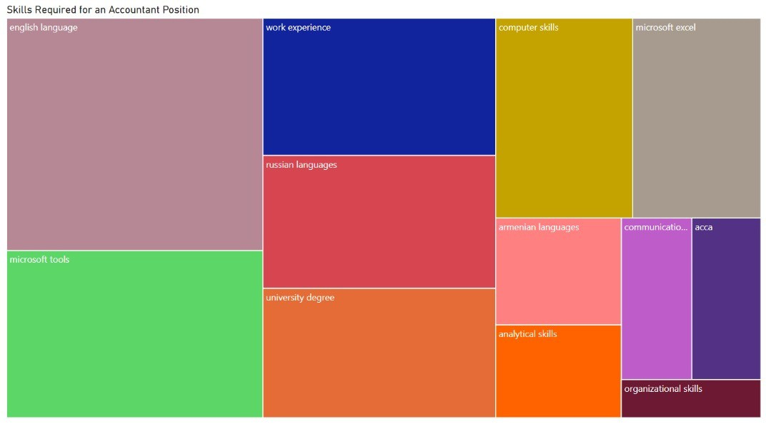

Slide 15
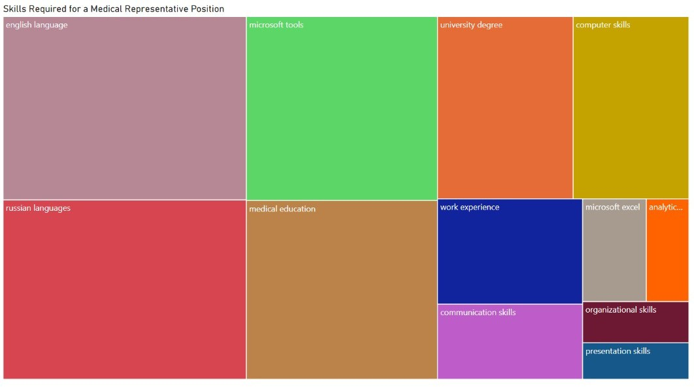

Slide 16
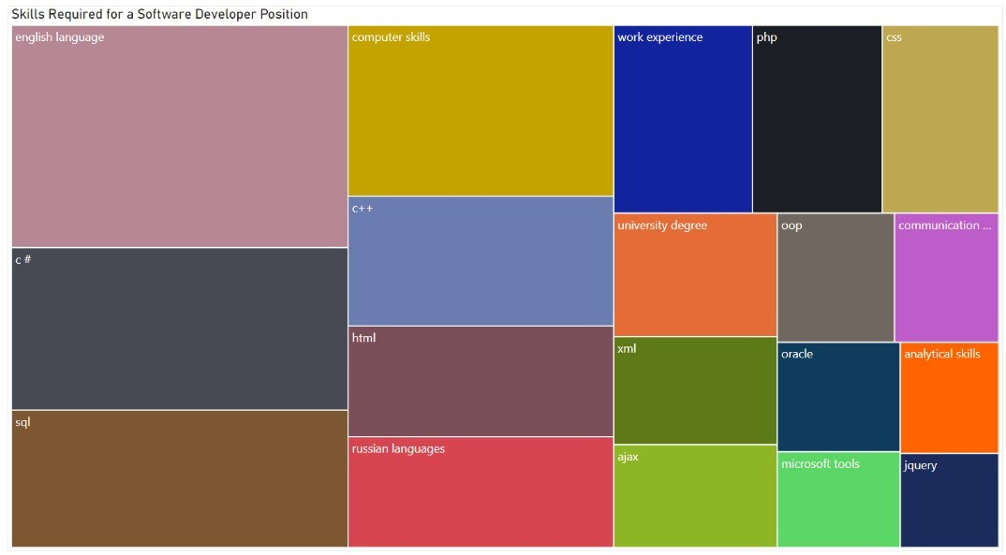

Slide 17
Recommendations
Microsoft Office Tools is important for both IT and NON-IT jobs
Attain fluency in the English language, as well as Russian languages and Armenian languages
Targeted job applications in March have a higher chance of success.
Internships in for job position would help provide the relevant work experience needed

Slide 18
Thanks for Listening

